Slide 1
Introduction to SR and light sources
Manuel Sanchez del Rio
srio@esrf.eu
Advanced Analysis & Precision Unit, MEG/ISDD, ESRF

Slide 2
Outline
Generational intro
Light sources: BM, Wigglers and Undulators

Slide 3
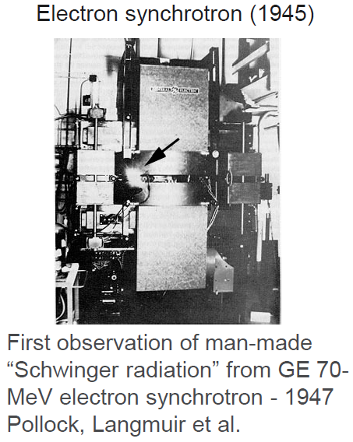
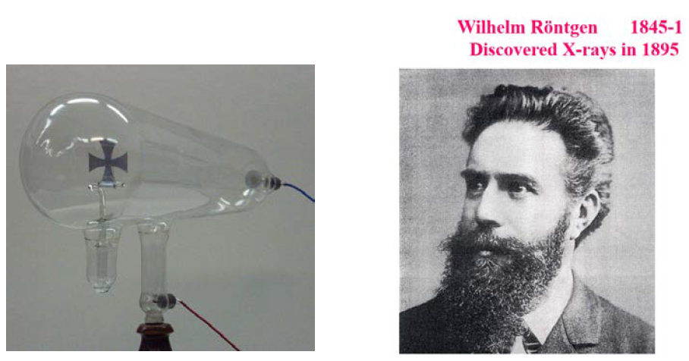
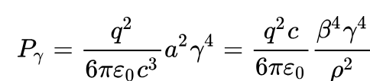
From X-rays to SR
https://doi.org/10.1119/1.13289

Slide 4
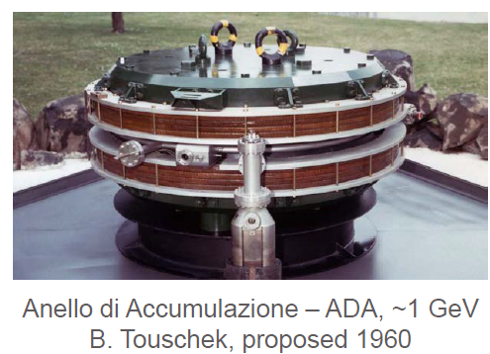
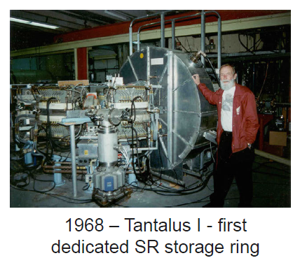
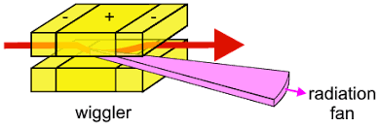
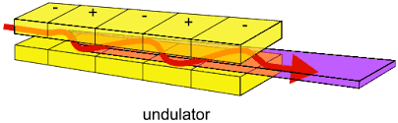
1st generation 1950-60 (parasite)
Moscow Univ/Lebedev Inst, DESY, Roma Univ/Frascati, Bonn Univ, NBS/Washington DC,
Univ of Tokyo, Cornell, CEA, NINA… SPEAR, DORIS, VEPP-3, DCI, CESR/CHESS, ...
end-1970-80 IDs
Winick et al (1981)
https://doi.org/10.1063/1.2914568

Slide 5
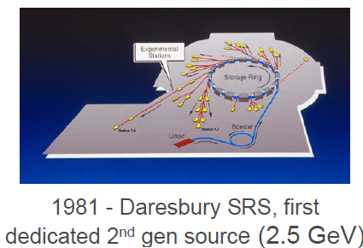
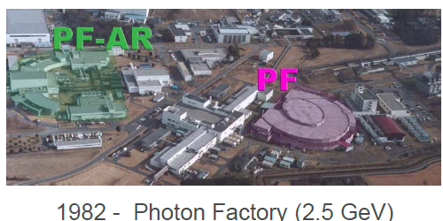
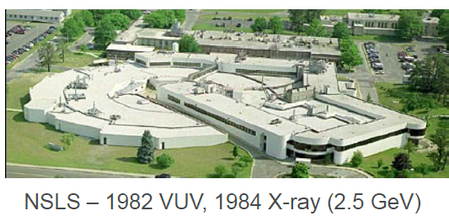
2nd generation (ε~100 10⁻⁹)
Parasitic or dedicated on storage rings using bend magnets and wigglers
Typically FODO lattices, few hundred nm-rad emittances
SOR-RING, SRS, Photon Factory, UV-SOR, NSLS-I, Aladdin, Super ACO, Hefei, …

Slide 6
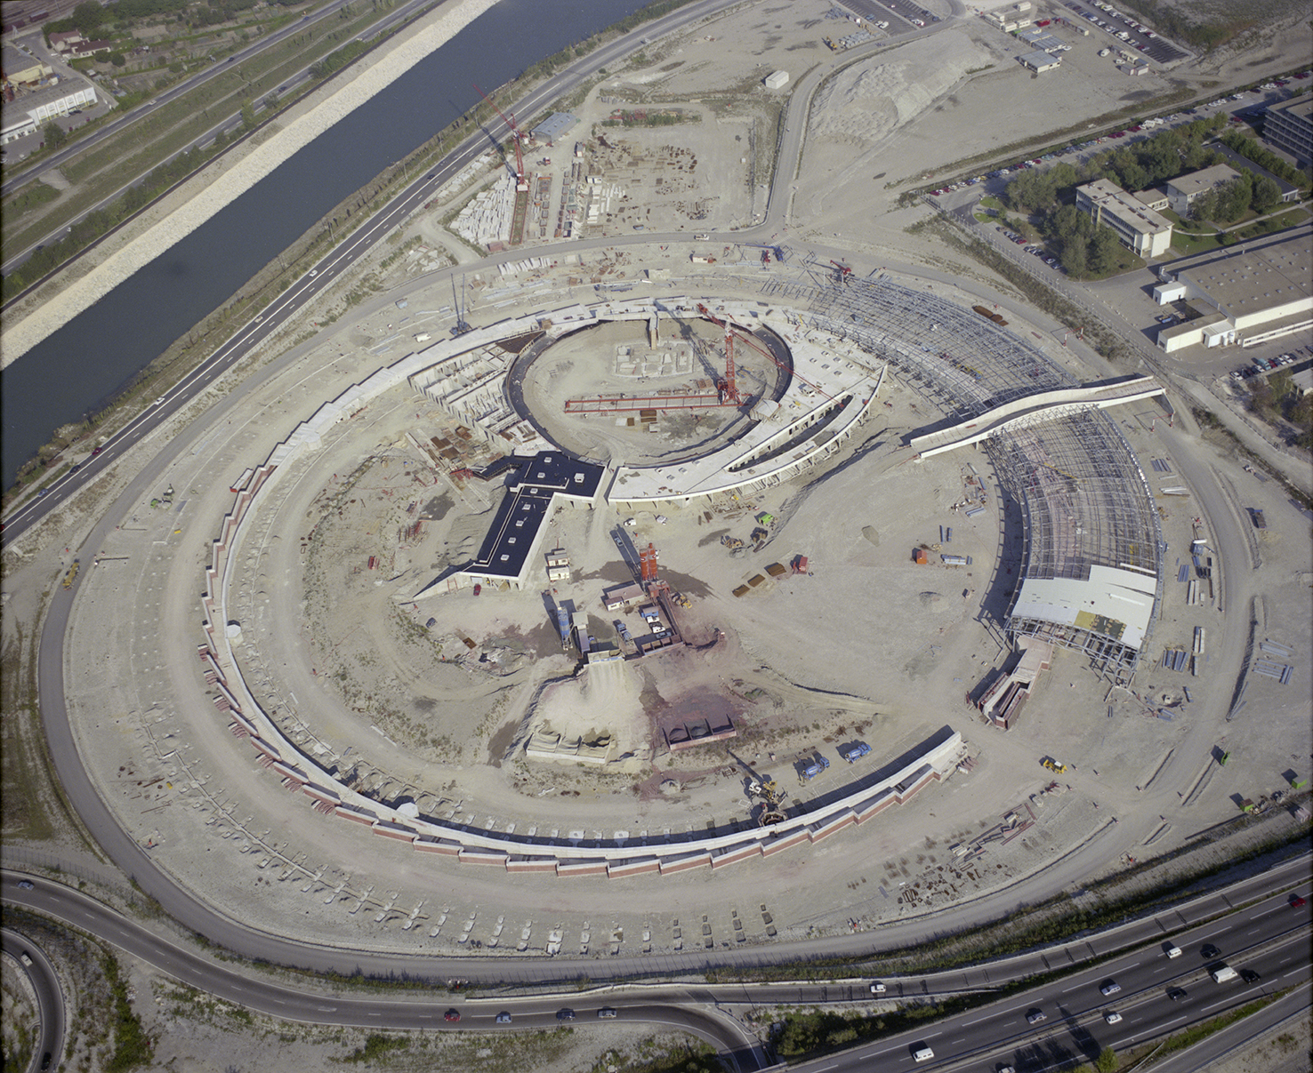
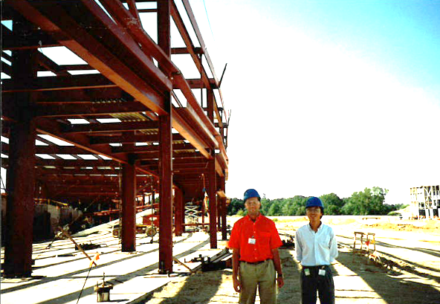
3rd generation (ε <10 10⁻⁹) – Dedicated and optimized for IDs
ESRF APS SPring-8 ALS ALBA BESSY-II SPEAR3 SLS DLS Soleil Elettra SSRF TPS PLS NSLS-II etc.

Slide 7
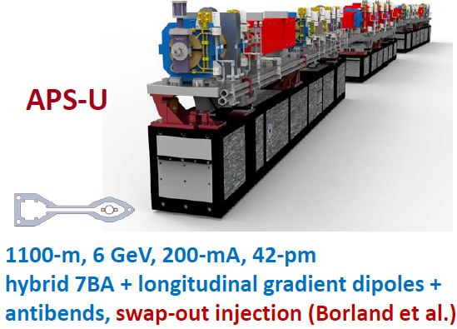
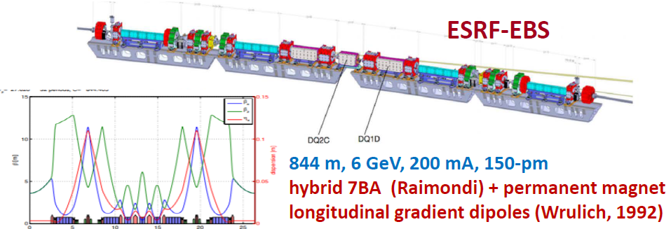
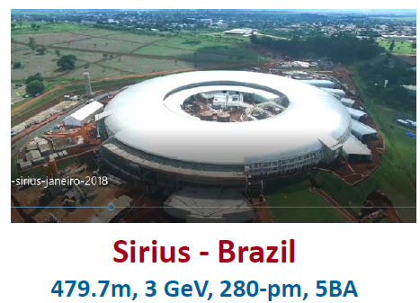
4th generation (ε ~ 100 10-¹²) – reduced H emittance to… DL?
MAX-IV, EBS-ESRF, …

Slide 8
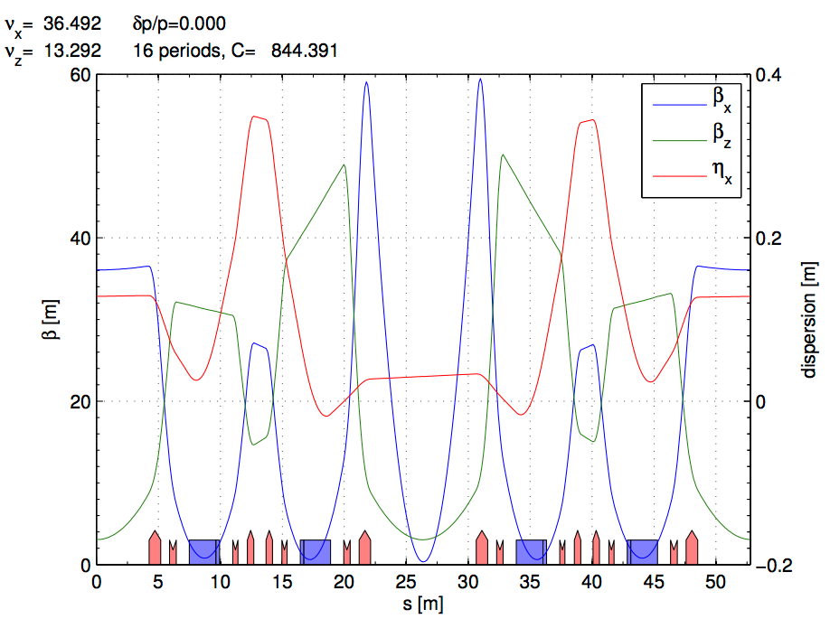
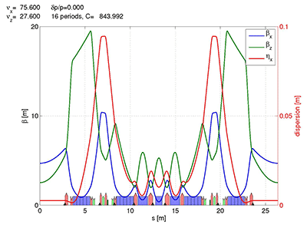
ESRF and EBS LATTICES
ESRF Double Bend Achromat (ESRF-1) -> Multi-bend achromat (EBS)
Horizontal emittance = 4000 pm Horizontal emittance = 137 pm
High Beta:
β_{x} = 37.59 m
β_{y} = 2.95 m
σ_{x} = 415.0 μm
σ_{y} = 3.43 μm
σ_{x’}= 10.3 μrad
σ_{z’}=1.16 μrad
Low Beta:
β_{x} = 0.35 m
β_{y} = 3.0 m
σ_{x} = 50.4 μm
σ_{y} = 3.44 μm
σ_{x’}= 107.2 μrad
σ_{z’}=1.16 μrad
EBS (S28D):
β_{x} = 6.90 m
β_{y} = 2.64 m
σ_{x} = 30.2 μm
σ_{y} = 3.64 μm
σ_{x’}= 4.37 μrad
σ_{z’}=1.37 μrad

Slide 9
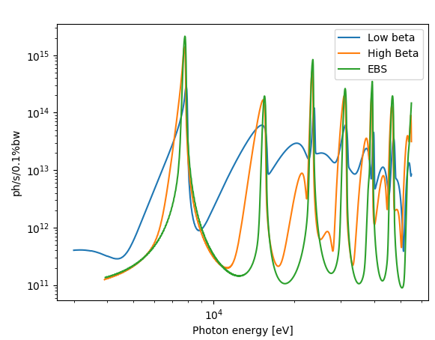
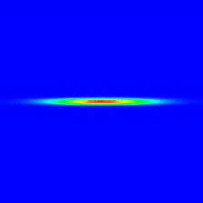
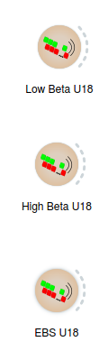
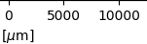
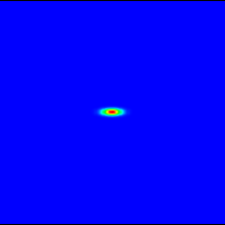
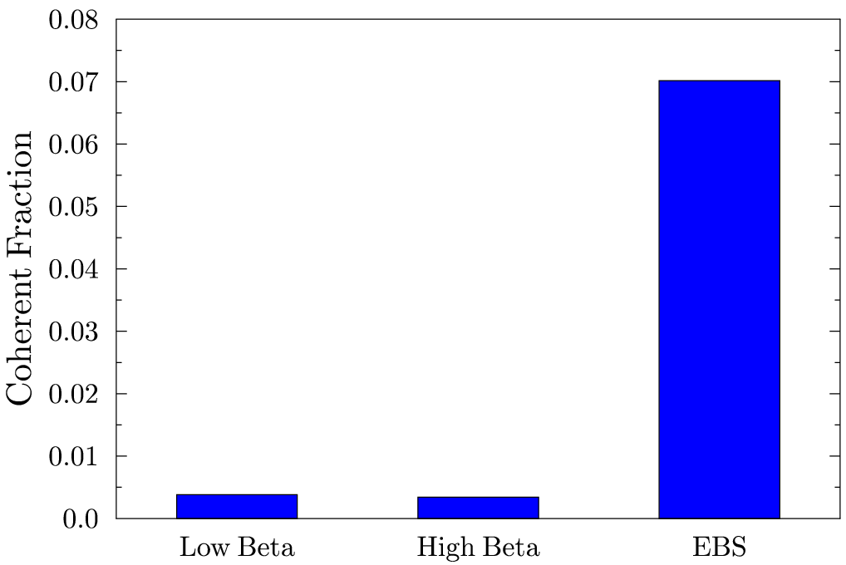
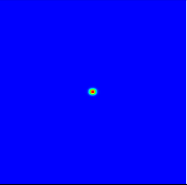
EBS – ESRF U18 2m @ 8 keV L=2m observed at 30m
Big increase of brightness and transverse coherence

Slide 10
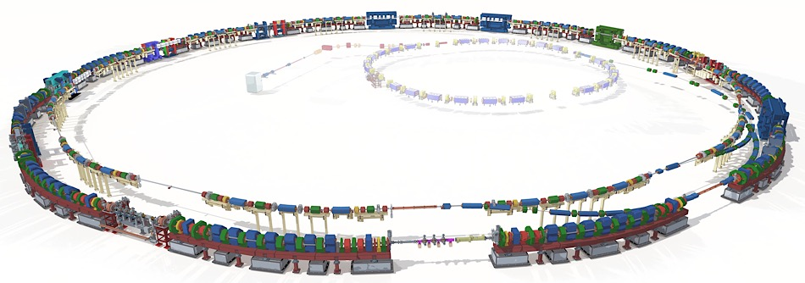
ALS-U
Electron Beam Profiles
Today’s ALS
Transfer lines
New full-length undulators optimized for high coherent flux
Linac
(existing)
Booster
(existing)
Future ALS
New 2.0 GeV accumulator ring for full-energy swap-out injection and recovery of bunch trains
New 2.0 GeV 9BA storage ring in existing tunnel optimized for low emittance and high soft x-ray brightness and coherent flux

Slide 11
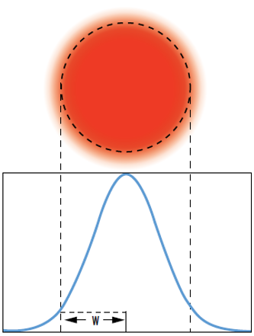
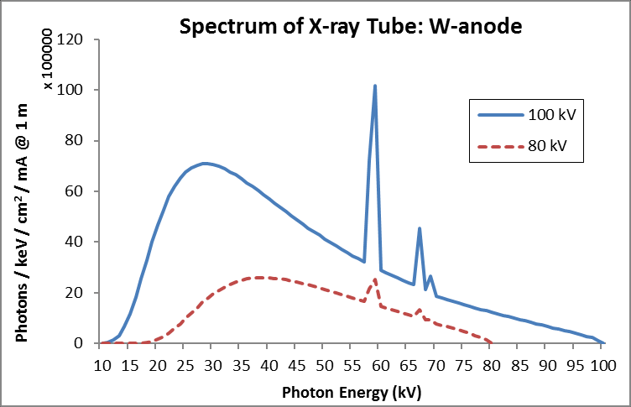
The Beam: Spectrum and Size
A light beam or beam of light is a directional projection of light energy radiating from a light source.
Collection of particles [photons]
Collection of waves
The main parameters can be represented:
As histograms if they are discrete variables
As functions if they are continuous variables
Spectrum I(E) Beam profile I(x,y) [cartesian]
y
x
I(E,x,y)
CORRELATED!
Size: FWHM
If profile is Gaussian
FWHM = 2.355 $σ$

Slide 12
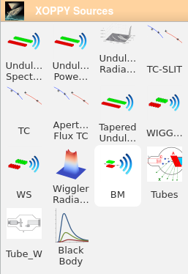
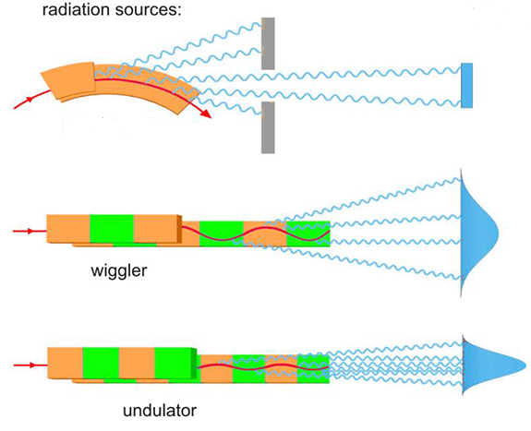
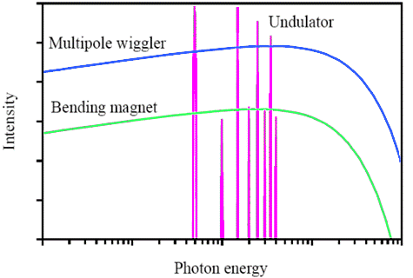
Simulation of source emission
Source spectrum (Photon flux or spectral power vs Energy)
XOPPY
Undulator
Wiggler
bending magnet
Bending
magnet

Slide 13
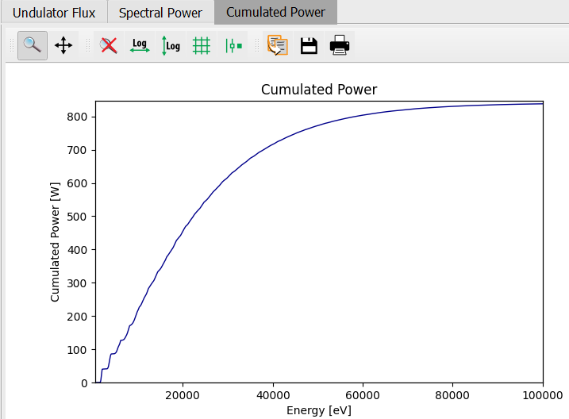
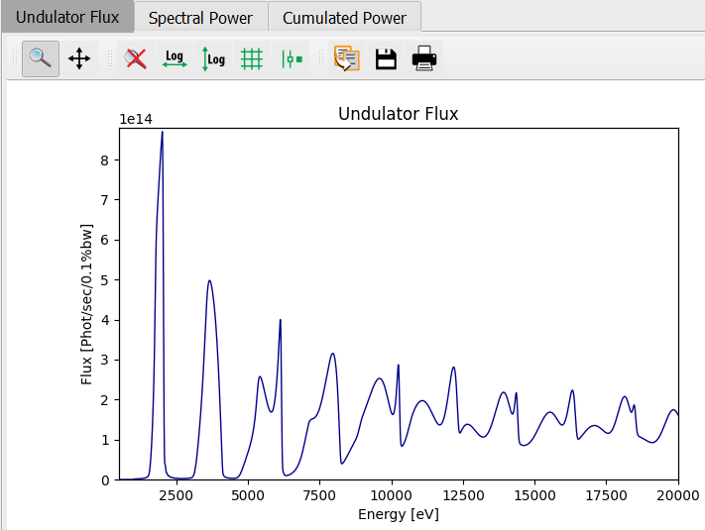
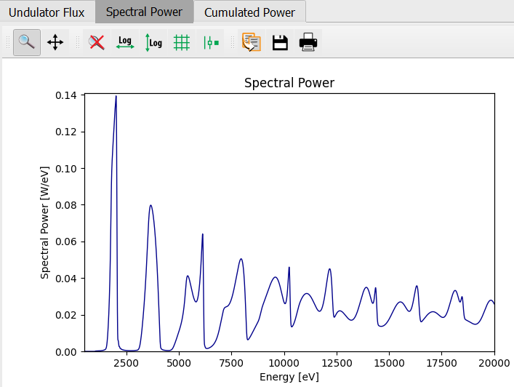
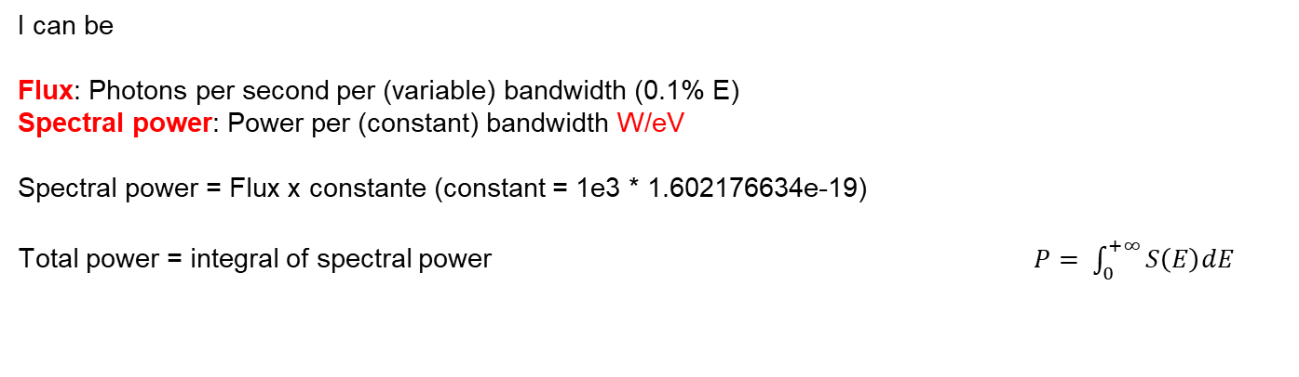
Intensity vs E
I can be
Flux: Photons per second per (variable) bandwidth (0.1% E)
Spectral power: Power per (constant) bandwidth W/eV
Spectral power = Flux x constante (constant = 1e3 * 1.602176634e-19)
Total power = integral of spectral power $P= \int_{0}^{+∞}{S\left(E\right)dE}$
cte = 1e3 * 1.6e-19

Slide 14
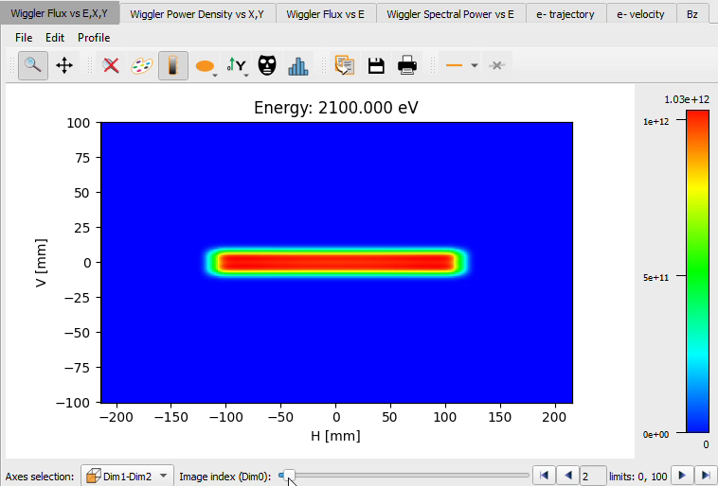
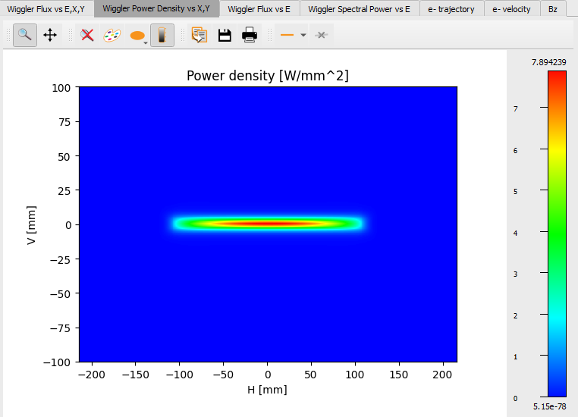
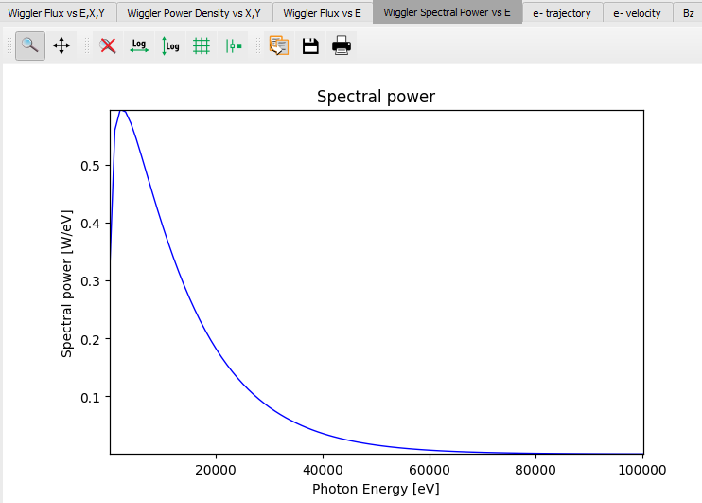
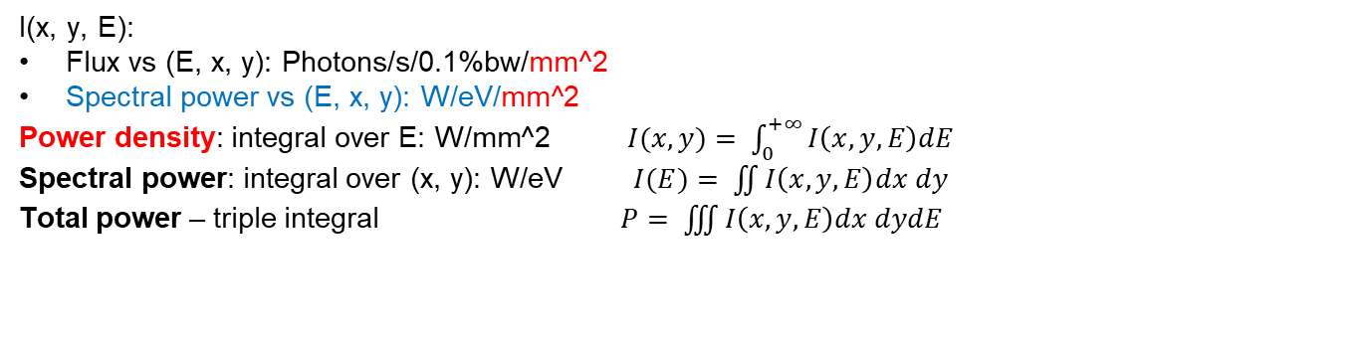
I(E) and I(x, y) are correlated (3D dependency)
I(x, y, E):
Flux vs (E, x, y): Photons/s/0.1%bw/mm^2
Spectral power vs (E, x, y): W/eV/mm^2
Power density: integral over E: W/mm^2 $I(x,y)= \int_{0}^{+∞}{I\left(x,y,E\right)dE}$
Spectral power: integral over (x, y): W/eV $I(E)= \iint{I\left(x,y,E\right)dx dy}$
Total power – triple integral $P= \iiint{I\left(x,y,E\right)dx dydE}$

Slide 15
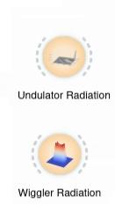
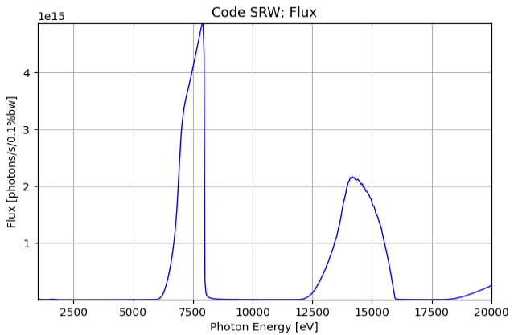
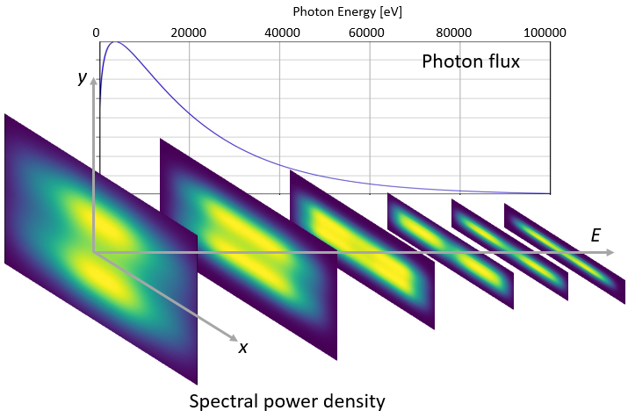
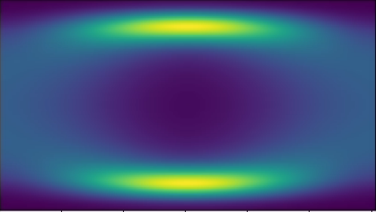
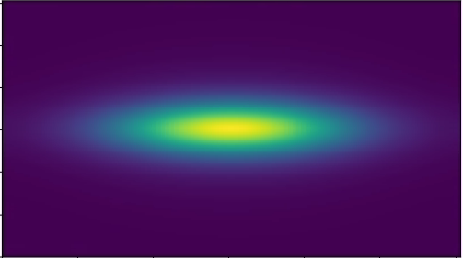
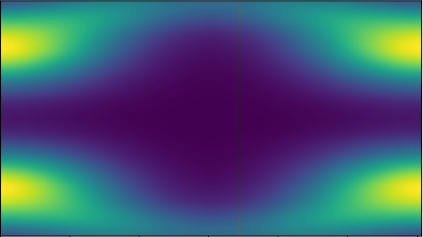
Examples of correlation between I(E) and I(x, y)
Undulator spectral flux density
(flux/power vs x, y, E)
Wiggler [and short ID’s] spectral flux density
(flux/power vs x, y, E)
Photon Energy [eV]
1000 5000 10000 15000 20000
y
Photon flux
E
x
Power density distribution of ESRF-3PW
https://jacow.org/medsi2020/papers/wepb17.pdf

Slide 16
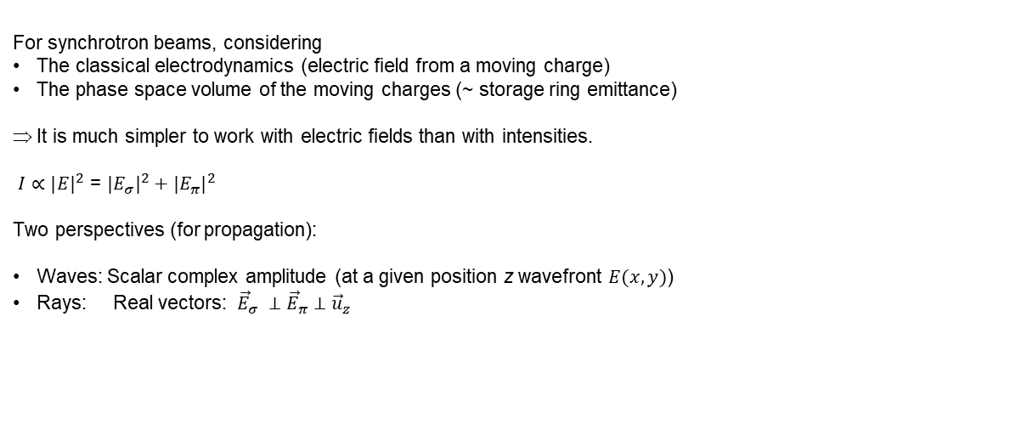
How “I” is calculated?
For synchrotron beams, considering
The classical electrodynamics (electric field from a moving charge)
The phase space volume of the moving charges (~ storage ring emittance)
It is much simpler to work with electric fields than with intensities.
$I∝{|E|}^{2}$ = ${|E_{σ}|}^{2}+{|E_{π}|}^{2}$
Two perspectives (for propagation):
Waves: Scalar complex amplitude (at a given position z wavefront $E(x,y)$)
Rays: Real vectors: ${\vec{E}}_{σ} ⊥{\vec{E}}_{π}$ $⊥{\vec{u}}_{z}$

Slide 17
Simulation of source emission
Undulator Spectrum (Flux/Spectral power)$I(E)$
Undulator power density (power vs x, y) $I(x,y)$
Undulator radiation (flux/power vs x, y, E) $I(E, x,y)$
Wiggler Spectrum $I(E)$
Wiggler radiation $I(E, x,y)$

Slide 18
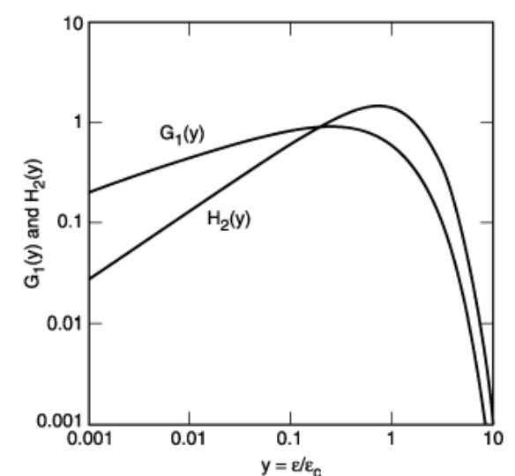
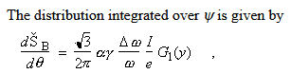
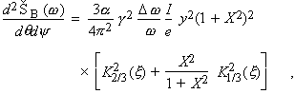
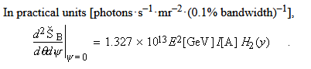
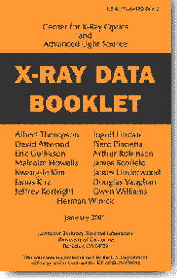


Bending magnets
https://xdb.lbl.gov/
See also: A A Sokolov and I M Ternov, Synchrotron Radiation, Akademik-Verlag, Berlin, 1968
https://srxraylib.readthedocs.io/en/latest/srfunc_examples.html

Slide 19





Insertion devices: K (deflection parameter)
$$K ≡\frac{eB_{0}λ_{u}}{2πmc}=0.9337B_{0}[T]λ_{u}[cm]$$

Slide 20















BM and wigglers: B(s), velocity e- trajectory

Slide 21




How Undulator Radiation is calculated?
Undulator

Slide 22





Undulator emission simulation
XOPPY
ESRF ID20 U32c
Undulator period
$$K ≡\frac{eB_{0}λ_{u}}{2πmc}=0.9337B_{0}[T]λ_{u}[cm]$$
$$λ_{n}=\frac{λ_{u}}{2γ^{2}n}\left(1+\frac{K^{2}}{2}+γ^{2}θ^{2}\right)$$
Photon wavelength
(harmonics)
Slit
“red shift”
$$θ$$
U42
30 m

Slide 23



Undulator emission simulation: Peak position vs aperture size
XOPPY
1st harmonic
$$λ_{n}=\frac{λ_{u}}{2γ^{2}n}\left(1+\frac{K^{2}}{2}+γ^{2}θ^{2}\right)$$
~50 eV
U42
Slit
$$θ$$
30 m

Slide 24


Undulator emission simulation: Peak position vs K
XOPPY
$$K↑ ⇒ λ_{n}↑ ⇒ E_{n}↓$$
$$λ_{n}=\frac{λ_{u}}{2γ^{2}n}\left(1+\frac{K^{2}}{2}+γ^{2}θ^{2}\right)$$
Memorandum:
$E\text{[}\text{eV}\text{]}= \frac{hc}{e}\frac{1}{ λ \text{[}\text{m}\text{]}}$= 1.2398e-06 $\frac{1}{ λ \text{[}\text{m}\text{]}}$
U42
$$K$$

Slide 25



Undulator emission simulation: Peak position vs K
XOPPY
$$λ_{n}=\frac{λ_{u}}{2γ^{2}n}\left(1+\frac{K^{2}}{2}+γ^{2}θ^{2}\right)$$
U42
$$K\sim B$$

Slide 26




Undulator emission simulation (gap)
$$e^{−}$$
Gap
$$K=0.9337B_{0}[T]λ_{u}[cm]$$
$$B_{0}=a∗e^{(−bπ∗\frac{gap}{λ_{u}})}$$

Slide 27

Undulator emission simulation
$$e^{−}$$
Gap
$$λ_{u}$$
Reducing
the gap
incrementing K
larger wavelength
$$B_{0}=a∗e^{(−bπ∗\frac{gap}{λ_{u}})}$$
$$K=0.9337B_{0}[T]λ_{u}[cm]$$
$$λ_{n}=\frac{λ_{u}}{2γ^{2}n}\left(1+\frac{K^{2}}{2}+γ^{2}θ^{2}\right)$$

Slide 28


Approximating emission on-resonance by Gaussians Onuki & Elleaume Undulators, Wigglers and their applications, CRC press, 2002
OASYS-Photon transport | HERCULES2024
Undulator radiation approximated by Gaussians (at resonances) are not Fourier pairs (like beams following the Gaussian Shell-model)

Slide 29










Electron energy dispersion effect in Undulator (on-resonance)
Single e⁻
Many e⁻
Photon source:
Divergence:
Size:
Emittance:
Tanaka & Kitamura:
Tanaka, T. & Kitamura, H. (2009).
J. Synchrotron Rad. 16, 380–386.
https://doi.org/10.1107/S0909049509009479
Sanchez del Rio, M. & Reyes-Herrera, J. (2025).
J. Synchrotron Rad. 32, 340–354.
http://dx.doi.org/10.1107/S1600577524004958

Slide 30


Electron energy dispersion effect in Undulator (off-resonance)
Note that the most changes (values that separate from one) are observed for small values of E − E0. We compared these results with the values from Nash et al. (2019) applied to our particular undulator. The map for angles (c) agrees well with our corresponding r.m.s. map (a)
[Nash, B., Chubar, O., Bruhwiler, D. L., Rakitin, M., Moeller, P., Nagler, R. & Goldring, N. (2019). Proc. SPIE, 11110, 111100K.]

